Slide 1

1st SACAC Control Engineering Hackathon
Water Challenge:
Optimal Control of a Rainwater Harvesting system
29 October 2018

Slide 2

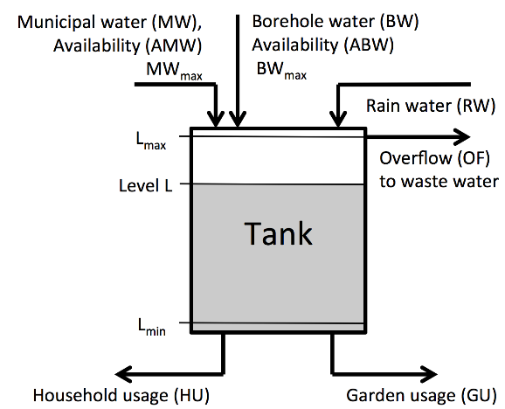

Slide 3
Municipal water specified (MW_{spec})
Borehole water specified (MW_{spec})
Manipulated variables

Slide 4
Disturbances
Household usage required (HU_{req})
Garden usage required (GU_{req})

Slide 5
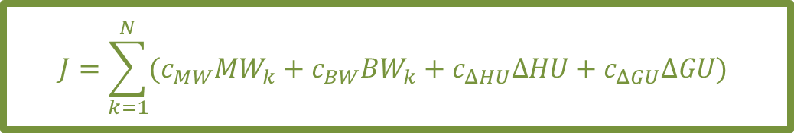
Optimization: Minimize objective function
$$J=\sum_{k=1}^{N}{(c_{MW}MW_{k}+c_{BW}BW_{k}+c_{ΔHU}ΔHU+c_{ΔGU}ΔGU)}$$
Controller structure
Sample time: 1 hour
Inputs: [L_{k}, L_{k-1}, …, L_{k-23}]
[HU_{k-1}, HU_{k-2}, …, HU_{k-24}]
[GU_{k-1}, GU_{k-2}, …, GU_{k-24}]
[AMW_{k-1}, AMW_{k-2}, …, AMW_{k-24}]
[ABW_{k-1}, ABW_{k-2}, …, ABW_{k-24}]
Outputs: MW_{spec}; BW_{spec}

Slide 6
Code structure
ExampleSimulation.m
Load data
Example1.mat
Iterate over 1 year of hourly data
Controller.m
TanksMassBalance.m
Performance calculation
Plotting

Slide 7
Solution presentation
7 minutes
How your controller works
Why you chose this structure
How you determined parameters
Performance on training data
Reflection on real-world potential

Slide 8

